Slide 1
Event Kick Off

Slide 2

Welcome To the first Global Power Platform Bootcamp

Slide 3
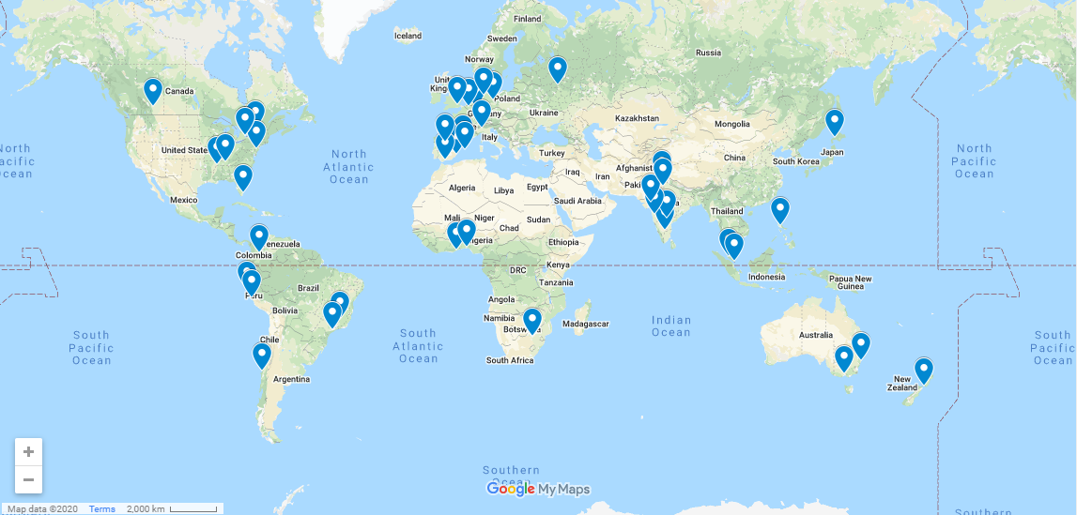
44 Locations Across the world!

Slide 4
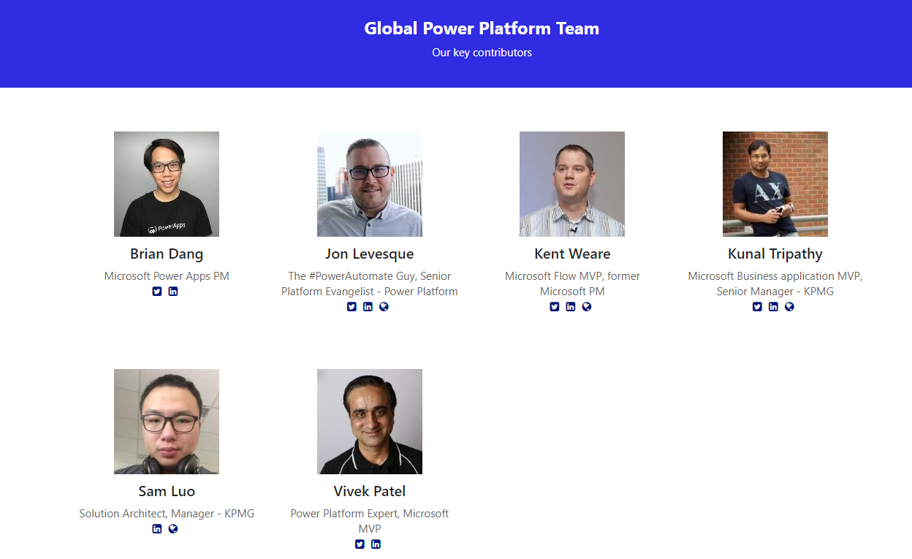
Notes:
Lets Hear from Them!!

Slide 5

Notes:
Lets Hear from the Global Team, Play video(only works in presentation mode), If any issues with video play it from here: https://www.youtube.com/watch?v=ZnLoqP6VIko&feature=youtu.be

Slide 6


Thanks To Our Global Sponsor

Slide 7

Notes:
KingswaySoft sponsor video, Play video

Slide 8




Thanks To Our Local Sponsor’s
Notes:
Add Local Sponsor detailsh

Slide 9
Thanks To Our Local Sponsor’s
Notes:
Add Local Sponsor detailsh

Slide 10
Thanks To Our Local Sponsor’s
Notes:
Add Local Sponsor detailsh

Slide 11
Thanks To Our Local Sponsor’s
Notes:
Add Local Sponsor detailsh

Slide 12
Thanks To Our Local Sponsor’s
Notes:
Add Local Sponsor detailsh

Slide 13
Thanks To Our Local Sponsor’s
Notes:
Add Local Sponsor detailsh

Slide 14


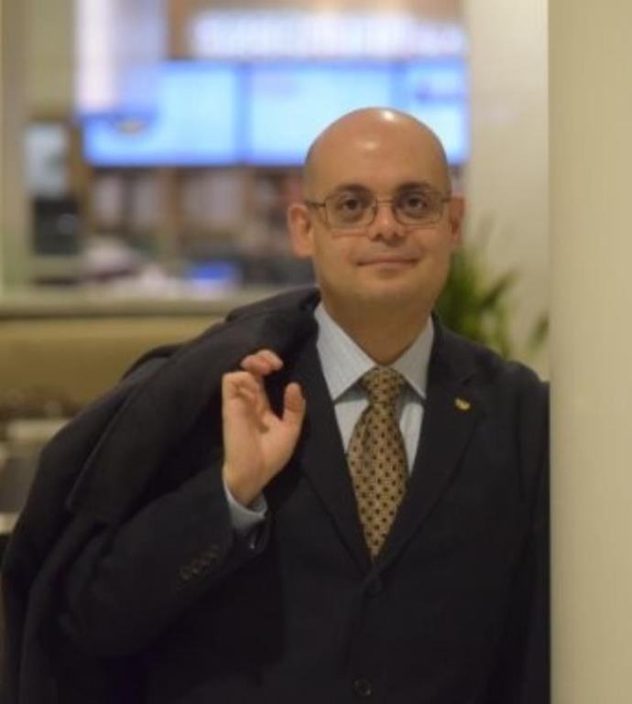
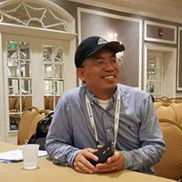
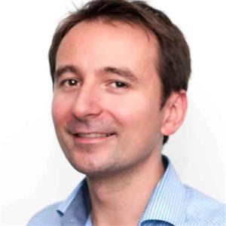
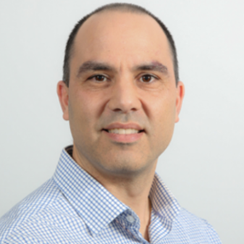
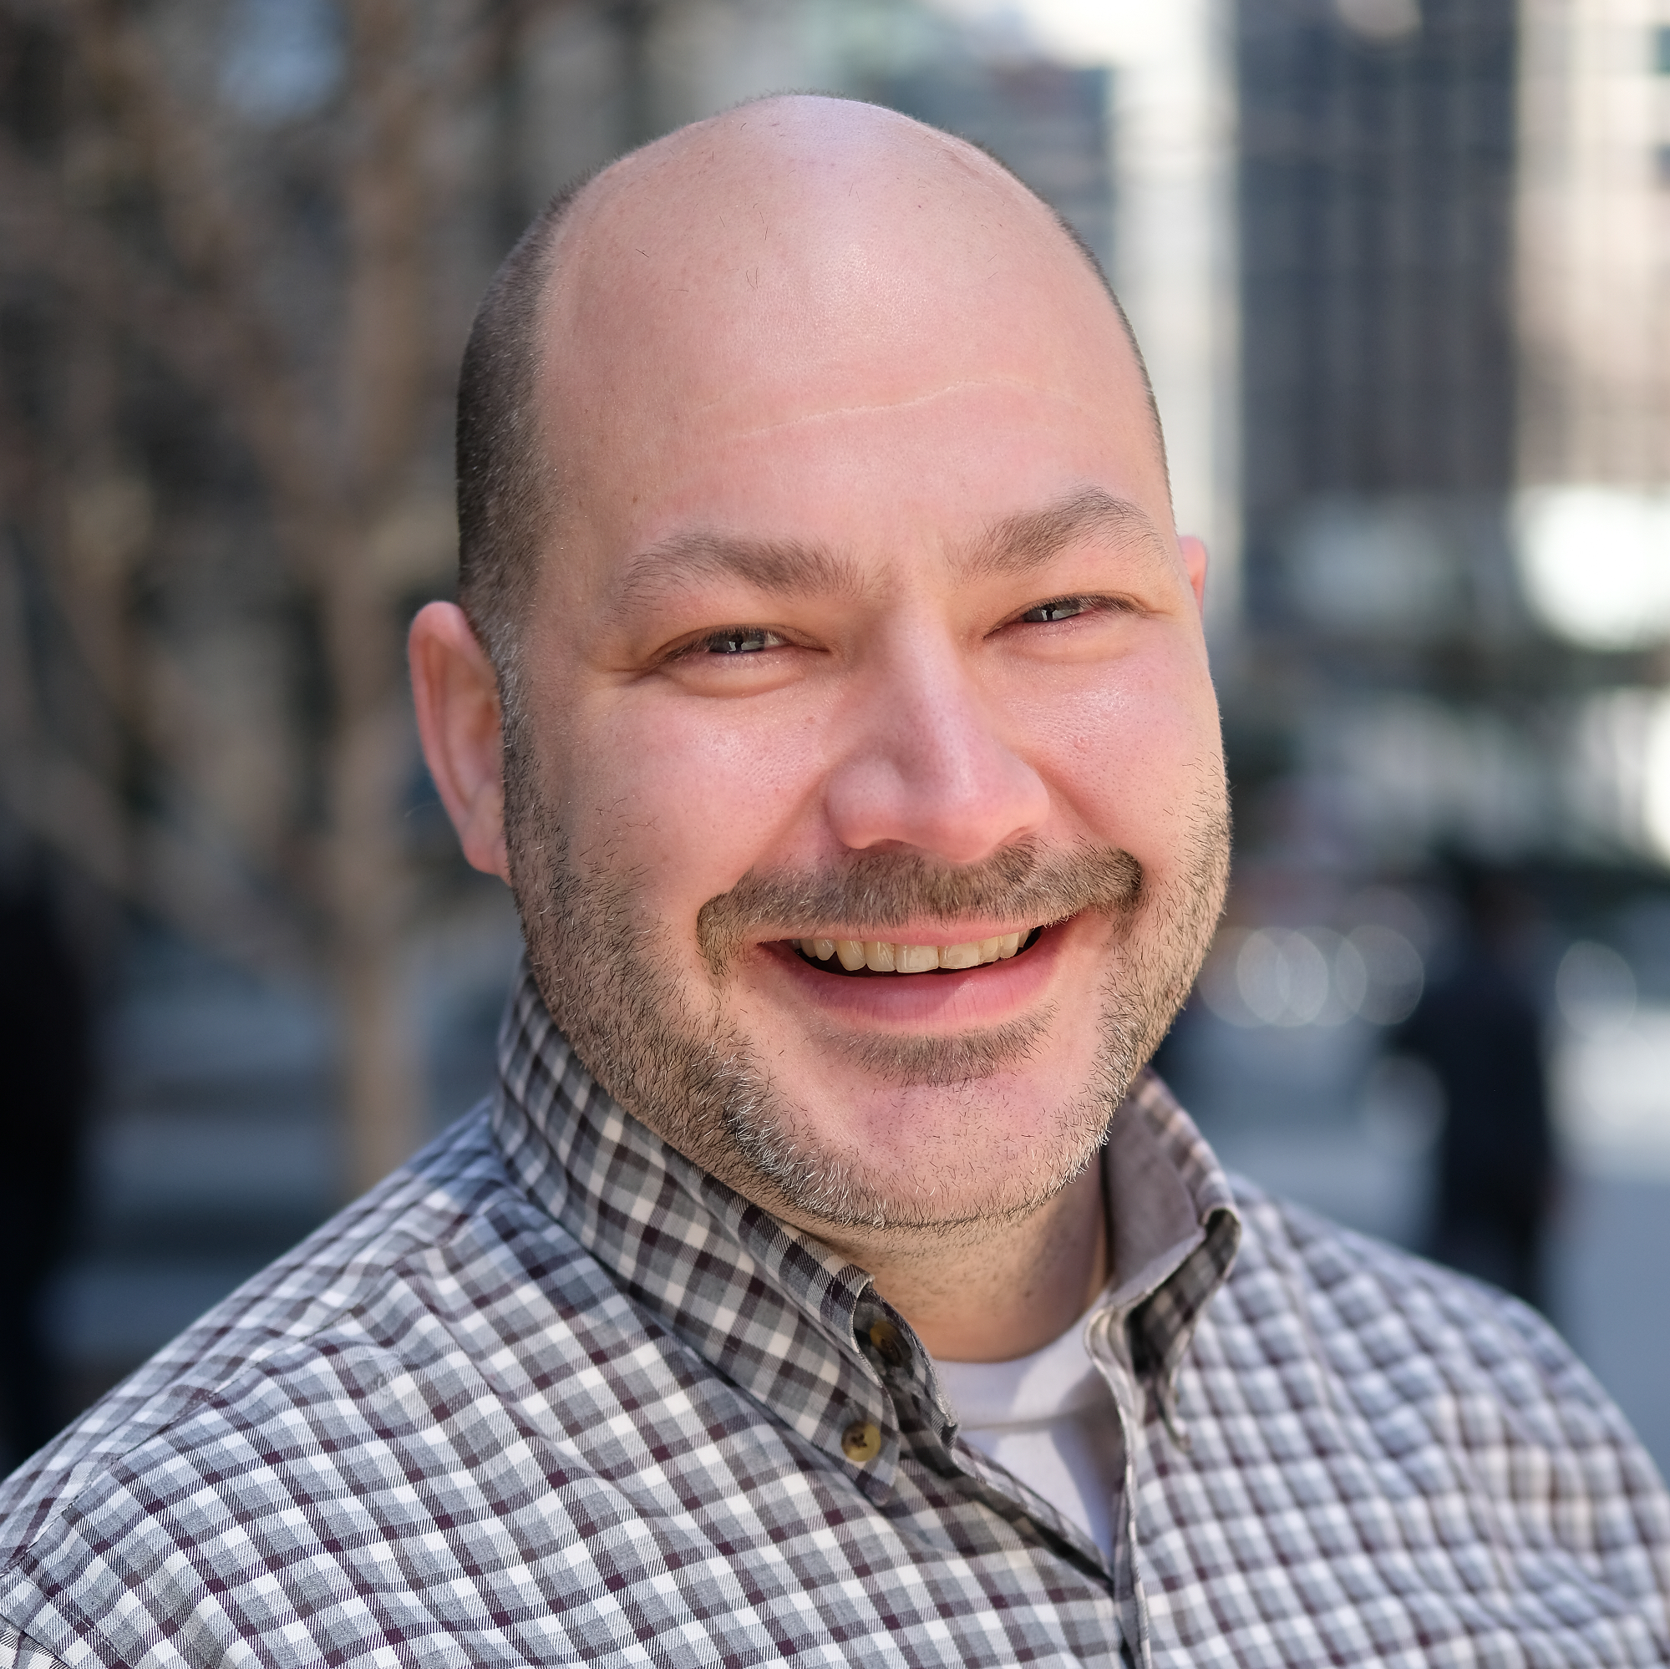
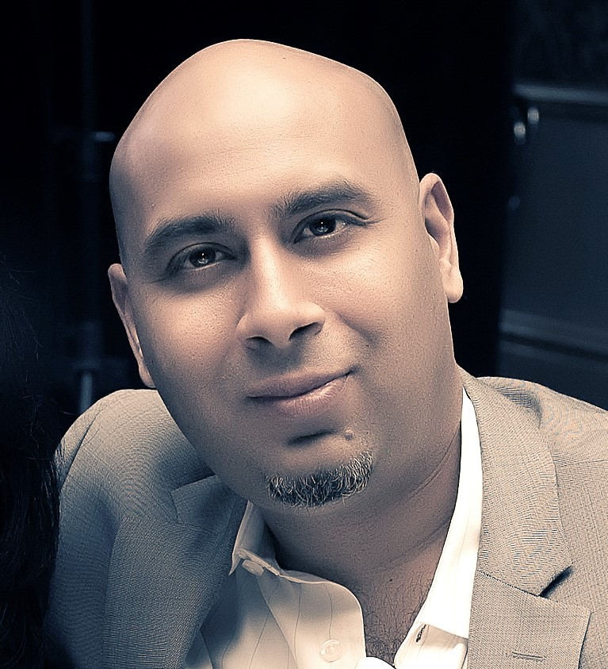
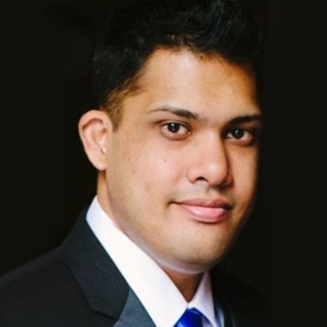
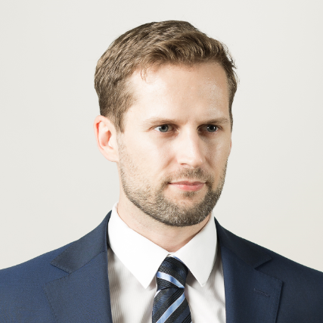
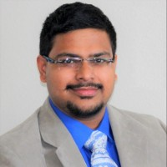
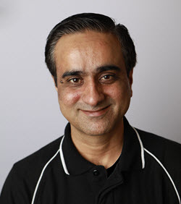

JOIN US AND OUR POWER EXPERTS AT THE OFFICIAL EVENT IN LAGOS WITH HANDS-ON SESSIONS AND LABS
GLOBAL POWER PLATFORM BOOTCAMP
15th FEBRUARY 2020, Microsoft Canada(1950 Meadowvale Blvd, Mississauga, ON L5N 8L9)
09:00 AM – 05:00 PM
REGISTER FREE HERE: Global Power Platform Bootcamp
Ashraf Ghonaim
Strategic Management
Consultant
Daniel Cai
Principal Developer,
Denis Molodtsov
Technical Architect
Haniel Croitoru
Enterprise Architect
Hugo Bernier
Independent Consultant
Noorez Khamis
Cloud Solutions Architect
Paras Dodhia
Founder
Simon Nuss
Director of Data & Analytics
Vishal Pawar
Principal BI Architect
Vivek Patel
Founder
Sr. Director North America
DON’T FORGET TO BRING YOUR LAPTOP AND IDEAS

Slide 15
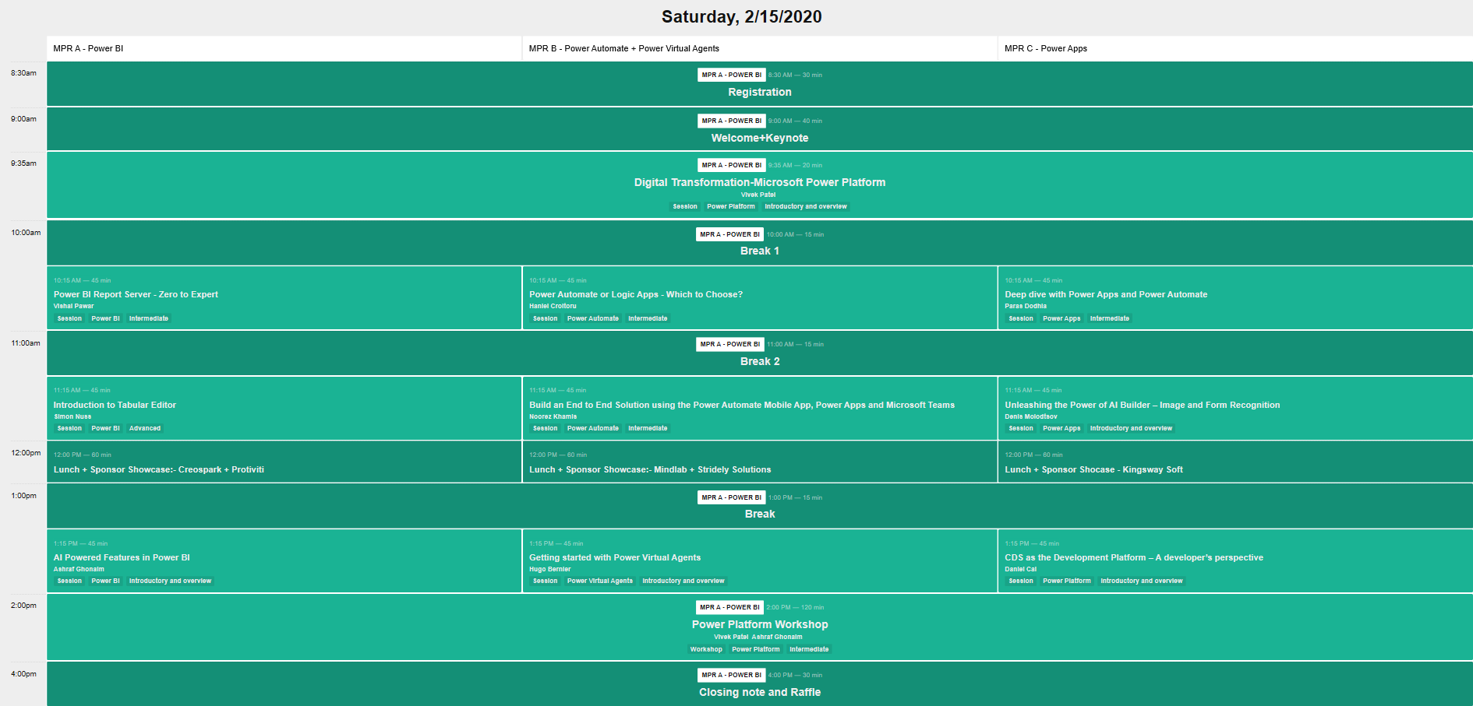
Schedule for the day
Notes:
Add your Schedule

Slide 16
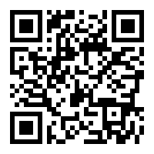
Schedule for the day
http://bit.ly/GPPB2020TorontoSession
Notes:
Update Url for schedule.

Slide 17
4-4:30 PM - Ruffle Draws to win Swags & Prizes

Slide 18
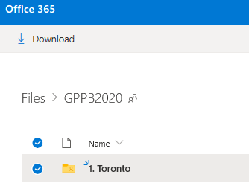
Social Media
Our Hashtags:
#GlobalPowerPlatformBootcamp
#GPPB2020
Twitter Handle: @GPPBootcamp
Share Pictures, videos and content: http://bit.ly/GPPBShare
Notes:
Lets Hear from the Global Team, Play video

Slide 19
House Rules:
Exit
Safety
Premises

Slide 20

Please fill out the survey! & Win Swags!! 10 prizes to be Won
https://www.powerplatformbootcamp.com/survey
Notes:
Survey Prizes will be announced on social media, 10 Prizes to be won!

Slide 21
Any Questions?

Slide 22
Kudopalooza Time!

Slide 23
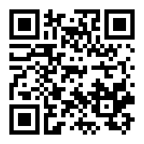
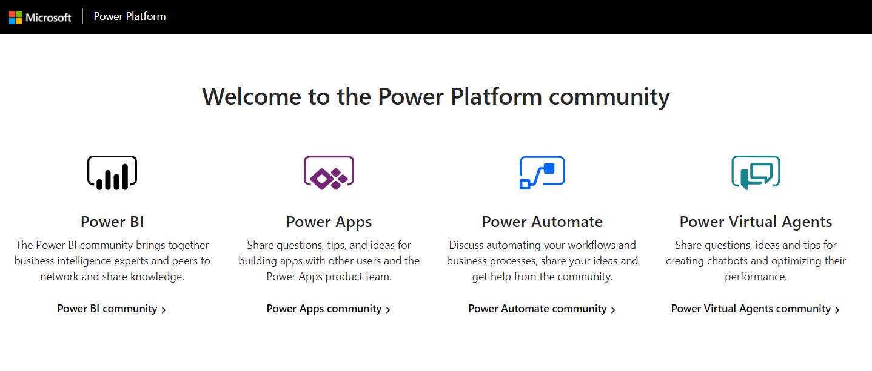
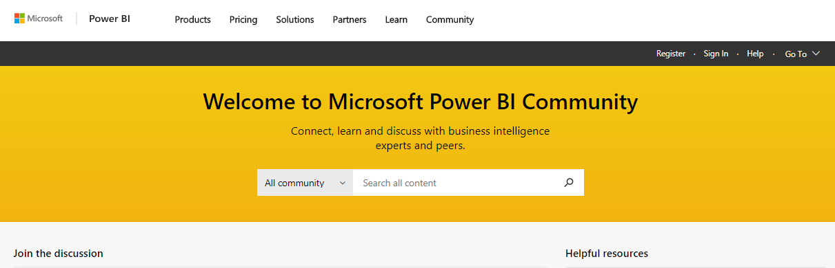

Kudopalooza for SWAG
Navigate to the community:
2. Click Register / Sign In*
3. Search for your event name
4. Click on the post for this event to open it
5. Kudo the post (click the thumbs up) for a chance to win a prize
Community.PowerPlatform.com
1
http://bit.ly/Kudopalooza_Toronto
2
3
*You must Register and sign in to join the fun!
Notes:
Kudopalooza for Swags, Is Microsoft Power Platform Community Team’s Initiative to get users registered and involved on Power platform Community websites. Essentially with this program, you present a short deck (attached) about the community during your event, and part of the deck instructs users to register and kudo a post in the community. From those who kudo’d the post, you select the winners; present them with certificates; and then after the event, Microsoft will get the swag shipped out to the winners.

Slide 24

Kudopalooza Winners are…
Notes:
Announce the winners

Slide 25
Have a Great Day!

